Slide 1

Team 3 Card Game Simulator
G. Douglass, D. Kelly, D. Naseem, K. Steele, A. Strom

Slide 2
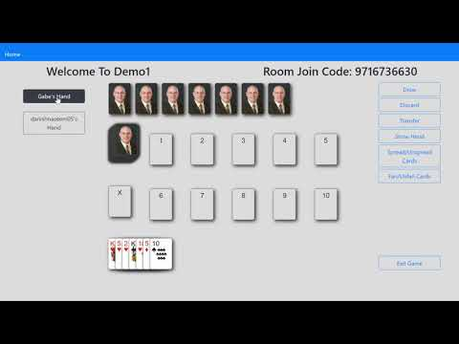
Product Demo
Notes:
Keep the YouTube volume to be around 20% - 30%

Slide 3
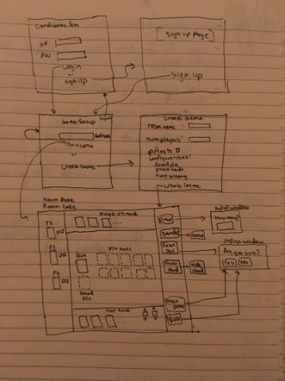
Behavior-Driven Design
Our Process:
As a team we defined User stories, managed them using Pivotal Tracker and turned them into acceptance tests with cucumber
Things Done Well
Created LoFi diagrams
Wrote user stories using pivotal tracker
Points were assigned in pivotal tracker using a Fibonacci method.
We had a target velocity for each sprint.
Areas For Improvement
User Stories could have been broken up
Often overestimated User Stories points each sprint. Usually due to a lack of research on the features' requirements

Slide 4
Test-Driven Development
Our Process:
Individuals/pairs responsible for using TDD in developing their feature
Things Done Well
High code coverage achieved ​
Tests supported development – tests revealed code failures; regression testing ​
Jasmine tests helped cover integration tests, stand-in for Cucumber acceptance tests where JS involved​
Areas For Improvement
Consistently writing failing tests before code
More comprehensive Jasmine testing – to avoid reliance on manual integration testing
Many user stories did not get acceptance tests written for them (Cucumber + JS problem)​

Slide 5
Adding To The Codebase
Project Successes
Protected Master Branch
Pull requests created for each feature, bug fix, or enhancement
CI pipeline pass prior to approval
Pull and test code locally
2+ Reviewers on each PR with significant changes
At least 1 outside review for small changes
Moved to staging and tested on Heroku staging app
Growth Throughout Project
Started with ~1 reviewer per PR
PRs started off slow
Did not initially use staging piece of pipeline to identify production server issues early on
Better discussion within PRs later in the project

Slide 6
Meetings
Structure
Met 3 times weekly: 20 minutes – 2.5 hours; met outside of this for bug fixing, help with features, and wrapping up sprints
Scrum Down: Accomplished, Impediments, future work
Agenda additions: demonstrating features, determining user stories, discussing feature integration
Growth Throughout Project
Sprint 1: no process for determining Scrum master; Sprint 2 we created a Scrum master schedule
Sprint 1 had specific minute-taker, Sprint 2 everyone took minutes, Sprint 3 Scrum master took minutes

Slide 7
Documentation/Communication
Wiki Pages
Repository of stated progress
Detailed enough to use as reference
Teams and Issues Tracking:
Communication primarily within Teams and PR comments
Issues mentioned on Teams would get their own branch and PR
Growth Throughout Project
Delegation of feature/project documentation
Clarity in implementation details
Notes:
Going more into the documentation and communication side of things a bit more,
We kept a Github Wiki filled with detailed meeting information and project progress that was updated and proofed at various points in the sprint.
This worked particularly well as a reference tool to prevent overlapping work
Most communication was done via the Microsoft Teams app and Pull Request comments.
Any issues or bugs mentioned on either would get their own branch and Pull Request discussions
Now, some areas we felt we should grow in are:
delegation of feature and project documentation, as it ended up being written by whoever got on top of it first.
And we could have been more clear on written implementation details to improve cross-feature integration

Slide 8
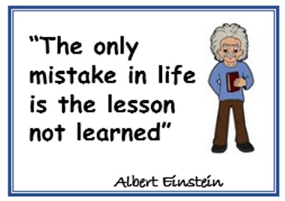
Lessons Learned
Spend time to define user stories well
Not to add in complex external libraries that might end up causing problems in the long run development.
Write comprehensive tests before writing code, not after.
Plan time for integration

Slide 9
APP URL
https://g003-cardgamesim-sprint3.herokuapp.com/
Otherwise, questions?
Notes:
Here's a link to our app if anyone wants to check out
Does anyone have questions?

